Slide 1
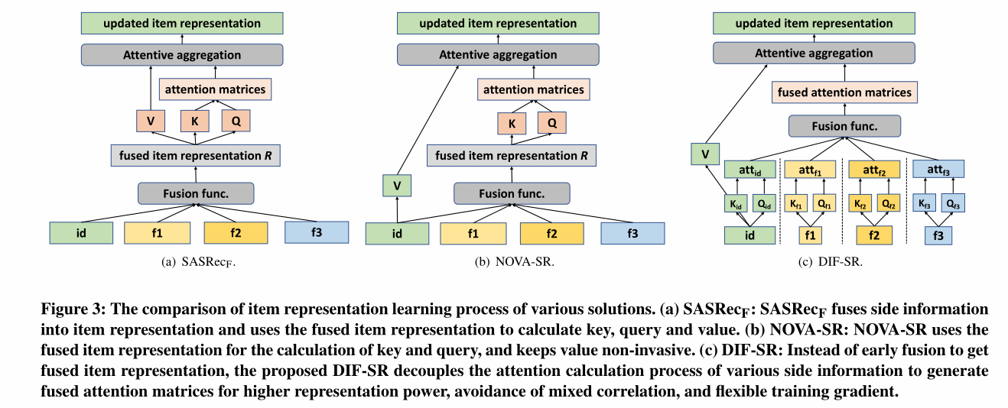
2022_SIGIR_Decoupled Side Information Fusion for Sequential Recommendation

Slide 2
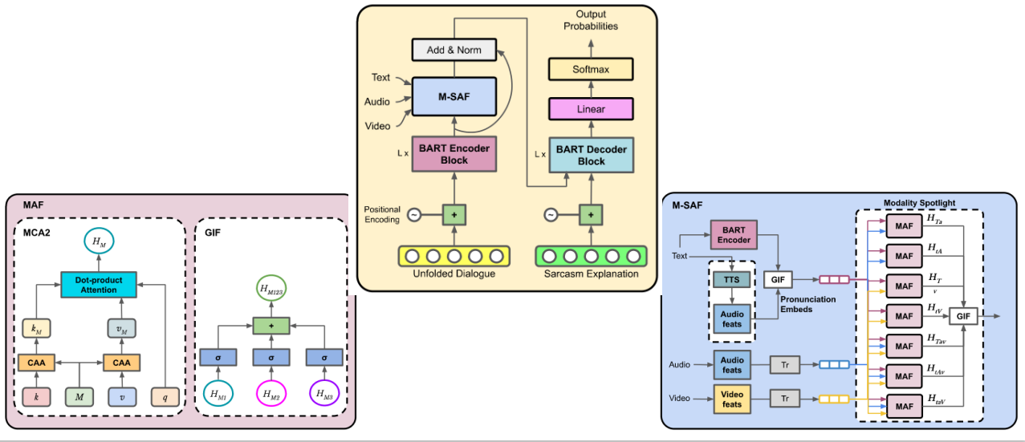
2023_AAAI_Explaining (Sarcastic) Utterances to Enhance Affect Understanding in Multimodal Dialogues

